Slide 1
Customer with 10s of millions of accounts in a custom user data store
Just In Time migration
Migrating accounts in without changing the users’ passwords
No impact to the customer experience
Keep legacy on-prem apps and new cloud apps running side-by-side

Slide 2
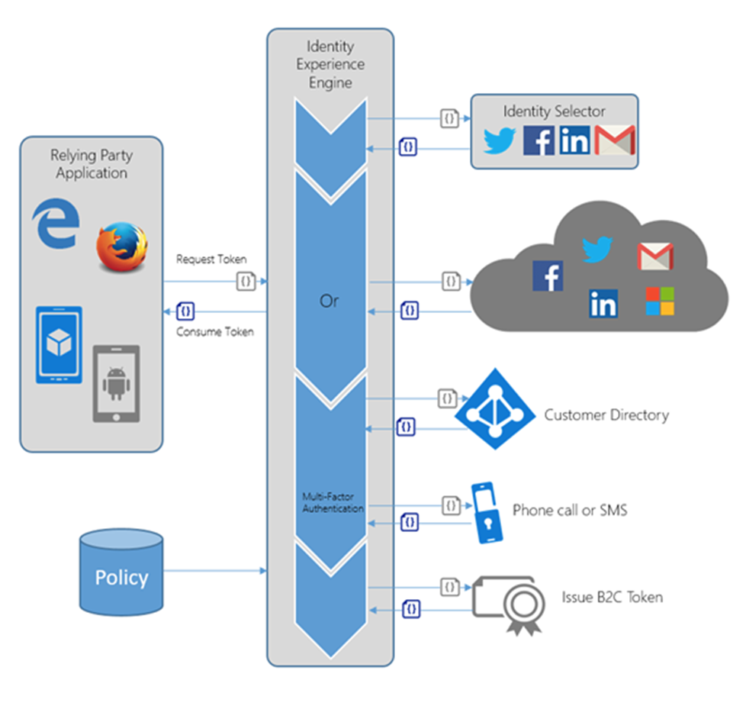
Identity Experience Engine

Slide 3





Just in time migration User SignIn
User not migrated
REST API
Azure AD B2C
Sign In Journey
casalaolab2c.onmicrosoft.com
userprofileapi.azurewebsites.net
1. Identity Provider Selection
2. Collect email and password
Send to REST API
3.Find User, get user profile data, User status (0) not migrated
4. AUTH email and password
User Store
casalaolab2c.onmicrosoft.com
b2csqlserver.database.windows.net
If exception then retry
5. Use GRAPH API to create new user with userProfileId as “key” with personal data including password
6. Update user status to migrated (2) in SQL User Store
7. Return userProfileId to B2C
8. B2C authenticates (new) user
9. Reads b2c directory to get additional claims needed for token
10. Issue B2C Token

Slide 4
Just in time migration User SignIn
User previously migrated
Azure AD B2C
REST API
Sign In Journey
casalaolab2c.onmicrosoft.com
userprofileapi.azurewebsites.net
1. Identity Provider Selection
User Store
2. Collect email and password
Send to REST API
3. Find User. Get profile data, User status (2) migrated
4. Return userProfileId to B2C
NO ACTION
b2csqlserver.database.windows.net
If exception, error msg then retry
5. B2C authenticates user
6. Reads b2c directory to get additional claims needed for token
7. Issue B2C Token

Slide 5
Just in time migration User SignUp
All New User
REST API
Azure AD B2C
Sign Up Journey
casalaolab2c.onmicrosoft.com
userprofileapi.azurewebsites.net
1. Use chooses signup
2. Collect email, verify email, get password
3. Collect Name, Country, DOB
User Store
casalaolab2c.onmicrosoft.com
b2csqlserver.database.windows.net
4. Validation
User not exist in b2c
If exception then retry
5. Create user in b2c
6. Call to rest API – create user
7.(OPTIONAL) Create user in user store, user status (3) –new user signed through B2C;
(OPTIONAL) no password recorded
8. Issue B2C Token

Slide 6
Implications Just In Time
Can use any data store for authentication (accessible securely via REST API or OAUTH)
Can create new users from any source
With Graph API can create users “on the fly”
With B2C itself as part of signup
Can call services via REST API and exchange Claims
“Inside” a B2C orchestration step (Validation)
As an orchestration step by itself
Orchestration flow can “fork” depending on the claims received

Slide 7
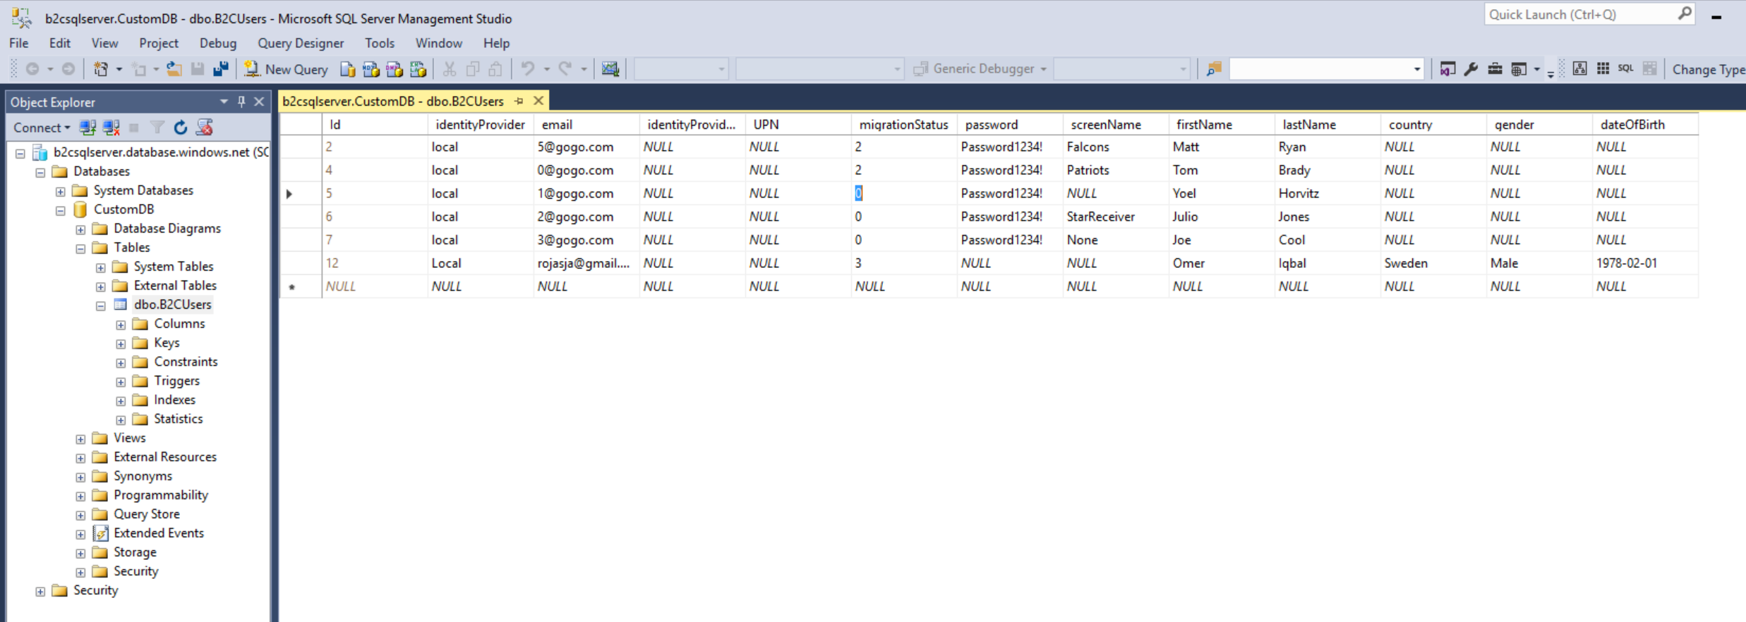
Sample source database

